Slide 1
Problem Statement (Hypothesis)
What opportunities exist for Big Mountain Resort to increase the revenue of all ticket prices by 10% through focusing on feature pricing premium tickets by an additional 5% of the closest company to benchmark and lowering costs of ticket prices by 5% with less access to features within this season.
H
1
Context
4
Constraints within solution space
The Big Mountain pricing strategy has been to charge a premium above the average price of resorts in its market segment. There's a need for profit maximization by increasing revenue. The market average is no longer the best indicator of premium pricing. The data science team is to implement a data-driven business strategy for selecting a better value for ticket prices. Other goals to cut costs at current ticket prices or support higher premium prices are also important.
Big Mountain Resort has recently installed an additional chair lift to help increase the distribution of visitors across the mountain. This additional chair increases their operating costs by $1,540,000 this season. Loyal customers will be use to current pricing and more sensitive to price changes.
2
Criteria for success
5
Stakeholders to provide key insight
The success constraints are that we are able to increase the revenue of all ticket prices by 10%. Feature pricing premium tickets by an additional 5% of the closest company to benchmark and lowering costs of ticket prices by 5% with less access to features within a month.
Initial stakeholders: Client: Big Mountain Resort; Director of Operations: Jimmy Blackburn;
Database Manager: Alesha Eisen;
Team: Data science team;
Information: Facility management and administration.
3
Scope of solution space
6
Key data sources
The focus will be on identifying target marketing features from sources of data, etc. Implementation of a data-driven business strategy will involve pricing based on benchmarking competition and cost based on quality features instead of average pricing of the industry. Analyze areas to cut costs at current or increased ticket pricing based on business practices.
Specific user level access granted to a SQL database or an S3 bucket.
A single CSV file received from database manager Alesha Eisen. The following is a link to a data snippet along with metadata column descriptions identify important columns.
CSV DATA SNIPPET [PAGE 5-6]
H
D
E
I
P
Notes:
Hypothesis: Create a Hypothesis with an emphasis on SMART principles. (S – Specific, M – Measurable, A – Achievable, R – Realistic, T – Timebound). If you cannot do this, you do not have a good grasp on the business problem.
Context: With context, we have clearly identified the problem at hand and have elucidated on how our initiative may solve this problem, alongside the commercial implications this will have on the business.
Criteria for Success: Clearly defining the criteria for success ensures that the scope of your work is clearly defined and understood. Otherwise, if this isn’t defined – your work will never end which will result in mismatched expectations.
Scope of Solution Space: Scoping out the solution space ensures that the business initiative is SPECIFIC for a certain segment or area. This prevents solutions that have been developed being scaled and applied for all other business units that the solution may not be responsible or scalable for.
Constraints within Solution Space: Looking forward, what are the foreseeable problems we are likely to encounter? Could this be stakeholder resistance? Could this be we don’t have access to the right data?
Stakeholders to provide key insight: Who are the people I need to speak to, to get the answers I need for my data analysis?
What key data sources are required?
Based off my discussions with the key stakeholders – can we clearly list out all the data sources we need so we can make a highly targeted request as opposed to a scatter-gun approach where we ask for a bit of everything?

Slide 2
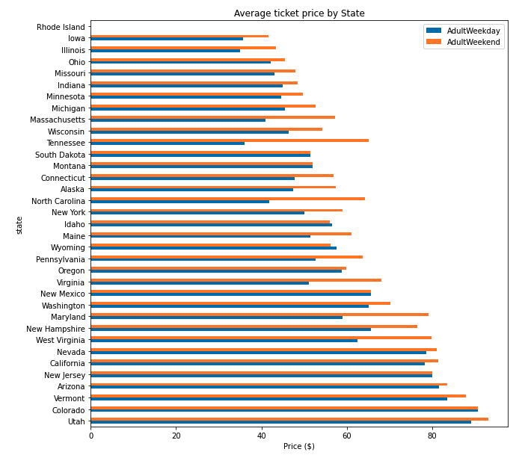
Problem Statement: Ticket Prices by State (Adult Weekday vs AdultWeekend)

Slide 3
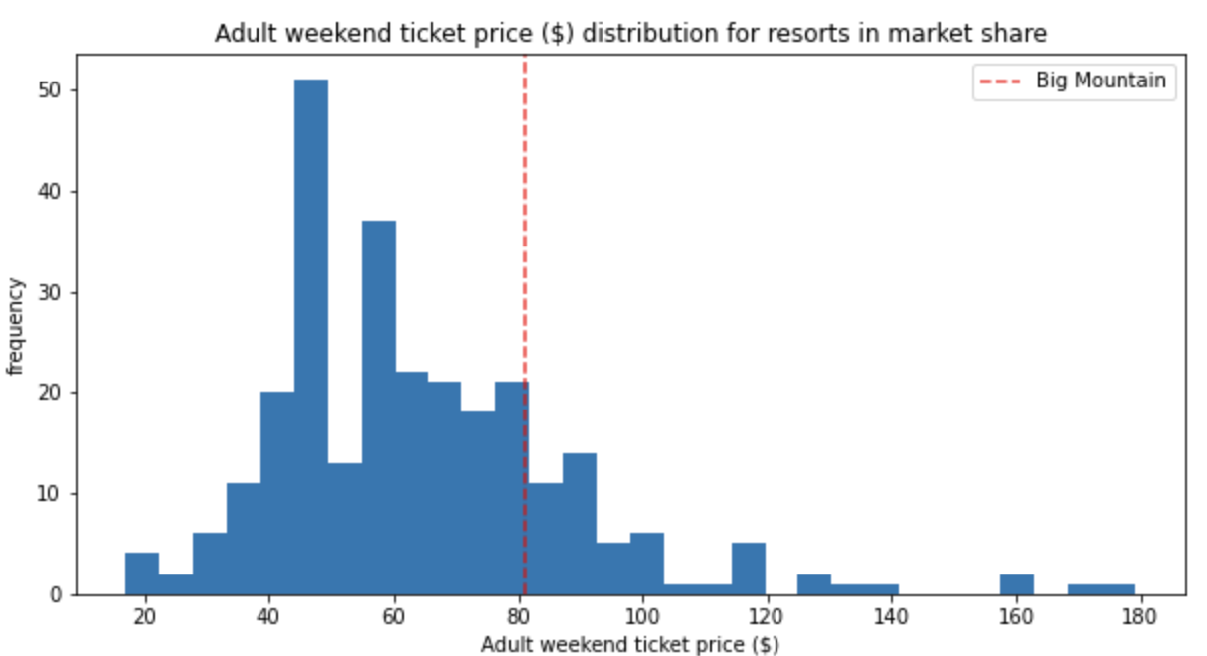
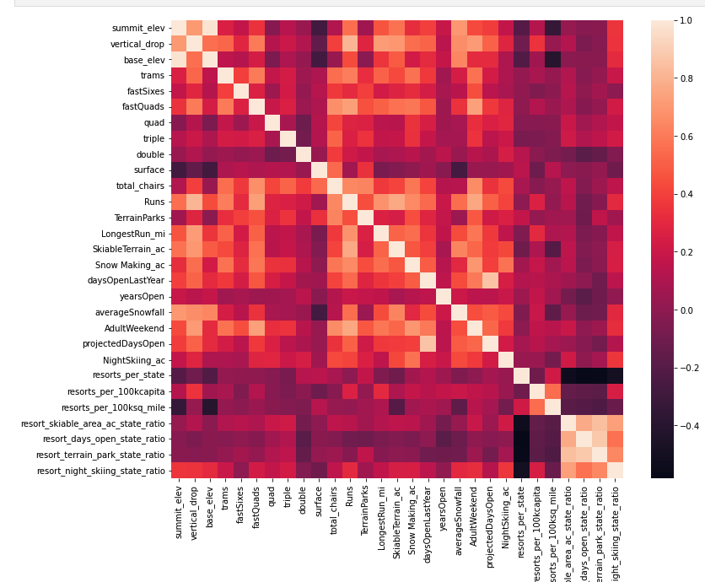
Recommendation and key findings:
Business aligned goal
Heatmap: high level view of relationships amongst resort services and features.
Four potential scenarios that can be represented using a model is the following:
1. Permanently closing down up to 10 of the least used runs. Does not impact any other resort statistics.
2. Increase the vertical drop by adding a run to a point 150 feet lower down but requiring the installation of an additional chair lift to bring skiers back up, without additional snow making coverage
3. Same as number 2, but adding 2 acres of snow making cover
4. Increase the longest run by 0.2 mile to boast 3.5 miles length, requiring an additional snow making coverage of 4 acres

Slide 4
Modeling results and analysis
Assumptions:
Other resorts are benchmarks for the market (or ticket-buying public) that sets the scope for the model.
model does not assume fair market practices and actual pricing of value at each resort.
model shows the expected number of visitors over the season was 350,000
on average, visitors ski for five days.
provided data includes the additional chair lift that Big Mountain recently installed.

Slide 5
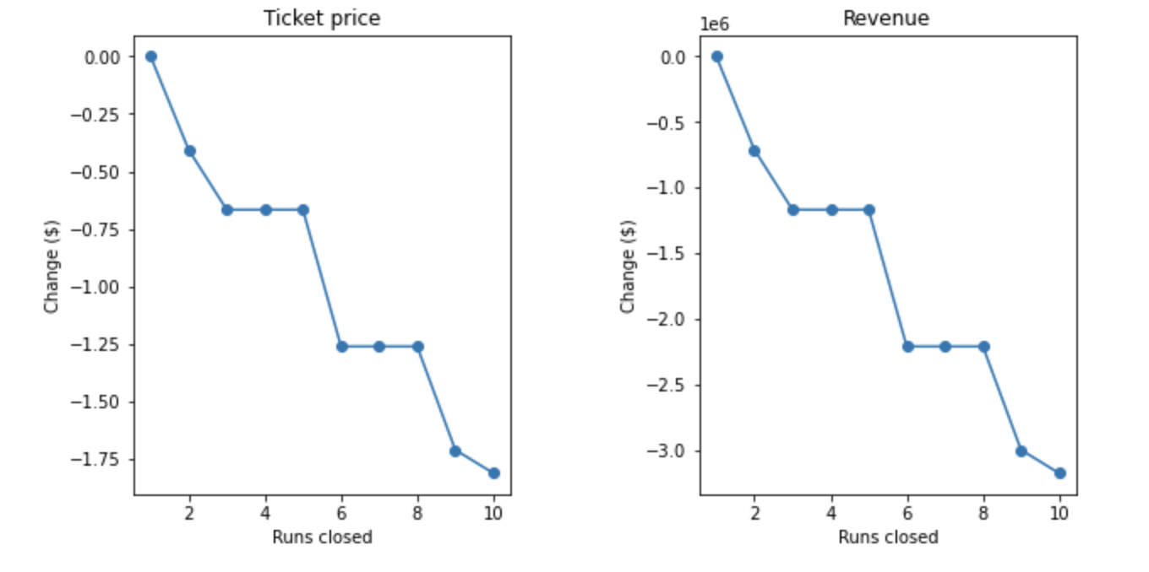
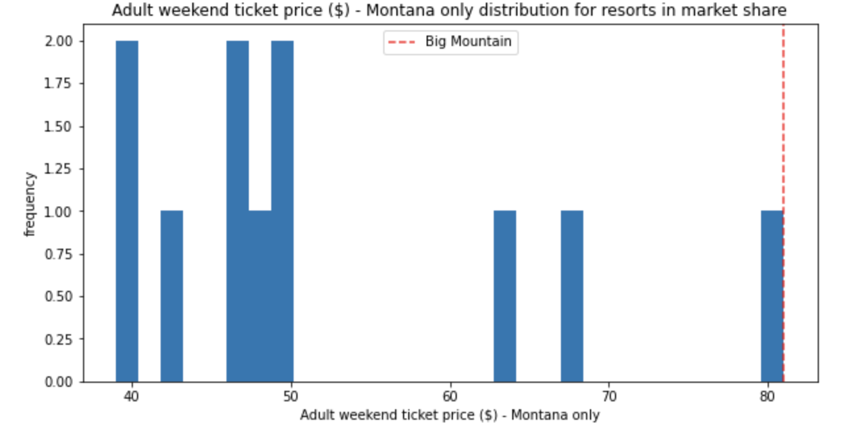
Modeling results and analysis
Example of certain features like runs closed directly related to a sharp decline in Revenue
Adult weekend ticket price and a clear difference in Montana’s distribution for resorts in market share.

Slide 6
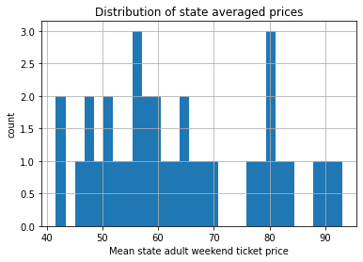

Modeling results and analysis
Based on the additional operating cost of the new chair lift per ticket (on the basis of each visitor at 350,000 on average buying 5 day tickets), the model supports an increase for ticket price by 1.99 dollars over the season. This could mean that approximately 3,474,638 per season would help with operational costs and revenue for the new chair lift.

Slide 7
Modeling results and analysis
Potential deployment and maintenance:
For future improvements, I recommend running a linear regression model because it is simple but also leads to similar reliability as Random Forests models when it comes to this data.
Testing can also be used by attempting to shut down certain features of the Big Mountain Resort during downtimes or weekends to observe how accurate model results are to actual results.

Slide 8
Summary and conclusion
Big Mountain Resort's current position/actual price for a weekend ticket is 81.00 dollars. Alternatively, when Big Mountain Resort was modelled the price was 95.87 dollars. With the expected mean absolute error or MAE of 10.39, the increase in price was aligned with the original goal of discovering how Big Mountain Resort could optimize their price point. It is clear there is definitely room for a higher price or they are underutilizing their potential price point by undercharging for ticket prices.

